Slide 1
CHAPTER 8 experiments

Slide 2
Experimental Research
What is the goal of experimental research?
  To establish the existence of a cause-and-effect relationship between two variables
  Must demonstrate that changes in one variable are directly responsible for causing changes in the second variable!

Slide 3
Four Basic Elements of Experiments
Manipulation
  Researcher manipulates one variable by changing its value to create a set of two or more treatment conditions.
  Manipulated variable == independent variable (IV)

Slide 4
Manipulation Example
Participants study a series of words:
  Half silently read each pair
  Half read each pair aloud
Different groups == levels of the IV

Slide 5
Four Basic Elements of Experiments
Measurement
  A second variable is measured for a group of participants resulting in a set of scores in each treatment condition.
  Measured variable == Dependent Variable (DV)

Slide 6
Independent vs. Dependent Variables
Independent and Dependent Variables:
  Independent – What’s being manipulated/Changed
  Dependent – What’s being measured

Slide 7
Four Basic Elements of Experiments
Comparison
  The scores in one treatment condition are compared with the scores in another treatment condition.
Control
  All other variables are controlled to be sure that they do not influence the two variables being examined.

Slide 8
The Classical Experiment
Major Components:
  Independent and Dependent Variables
    Pre-testing and Post-testing (Repeated measures)
    Experimental and Control Groups (Between Subjects)

Slide 9
The Classical Experiment
Independent and Dependent Variables:
  Independent (IV) – Takes the form of a stimulus (present or absent)
    The cause!
  Dependent (DV) – Effect
    The outcome!

Slide 10
Examples
Independent and Dependent Variables:
  Independent – Drug vs. Placebo
  Dependent – Anxiety Scores

Slide 11
Examples
Independent and Dependent Variables:
  Independent – Study Strategy
  Dependent – Test performance

Slide 12
Example
Participants in a study attend a lecture either in a classroom filled with natural light or in a lecture hall with artificial light and no windows. After class, participants fill out a mood survey.
What is the independent variable?
What is the dependent variable?

Slide 13
Two main designs
Between-Subjects
Repeated Measures (Within-Subjects)

Slide 14
Characteristics of Between-Subjects Designs
Experimental research using two (or more) groups of participants
  Goal: to determine whether differences exist between two or more treatment conditions
  Requirement: only one score for each participant is obtained
  Separate groups of participants are used for experiment and control groups!

Slide 15
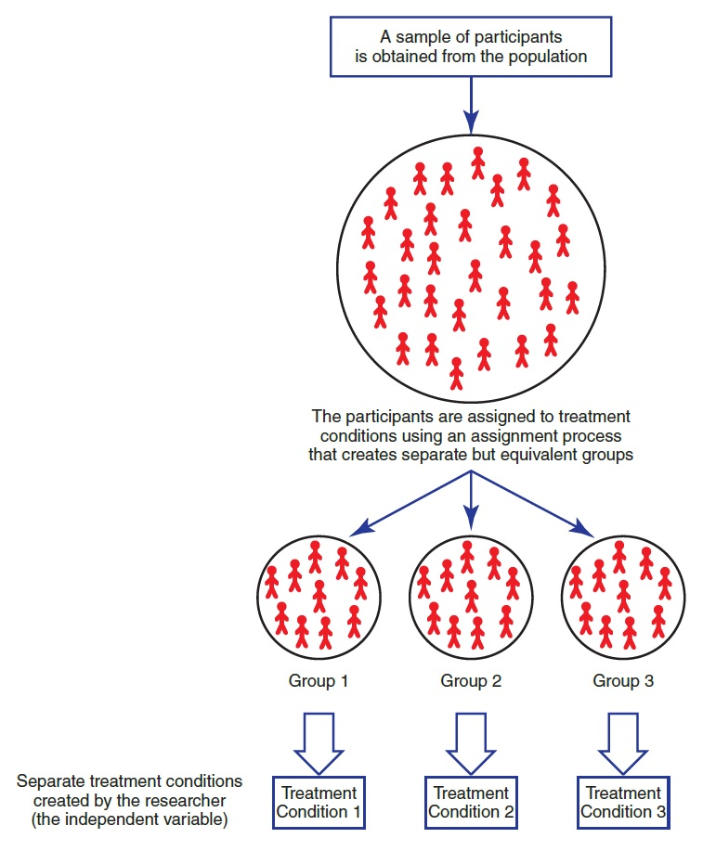
Notes:
Figure 8.1 The Structure of a Between-Subjects Experiment
The key element is that separate groups of participants are used for the different treatment conditions.

Slide 16
Repeated Measures/Within-Subjects
Uses a single group of participants and tests or observes each individual in all of the different treatments being compared
Same group of individuals participates in every level of the IV.
Study repeats measurements of the same individuals under different conditions

Slide 17
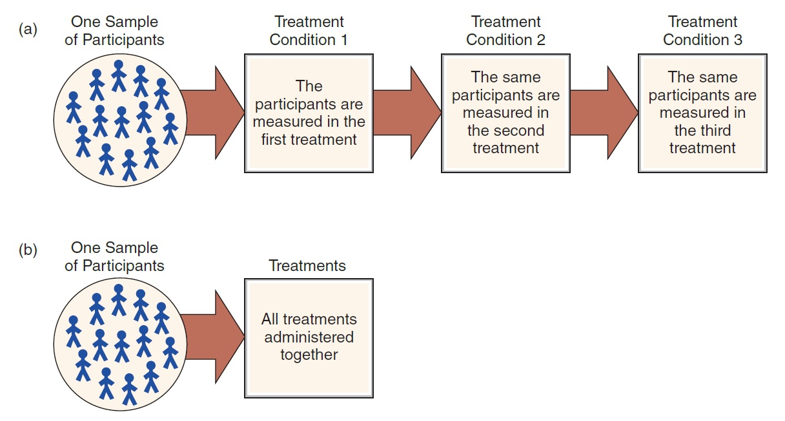
The Structure of a Within-Subjects Design
Notes:
Figure 9.1 The Structure of a Within-Subjects Design
The same group of individuals participates in all of the treatment conditions. Because each participant is measured in each treatment, this design is sometimes called a repeated-measures design. Note: All participants go through the entire series of treatments but not necessarily in the same order.

Slide 18
Advantages of Between-Subjects Designs
Each individual score is independent from all other scores.
The individual’s score is not influenced by:
  practice or experience gained in other treatments
  fatigue or boredom from participating in a series of different treatments
  contrast effects that result from comparing one treatment to another

Slide 19
Disadvantages of Between-Subjects Designs
Require a relatively large number of participants
  Example: three different treatment conditions with 30 scores in each treatment ► 90 participants are required
Each score is obtained from a unique individual who has personal characteristics different from all of the other participants.
  Individual differences!

Slide 20
Choosing Within- or Between-Subjects
Advantages of within- and between-subjects designs are essentially the same as the disadvantages of the other.
Three factors that differentiate the designs:
  Individual differences
  Time-related factors and order effects
  Fewer participants

Slide 21
When to use a Between-Subjects Design
Between-subjects design is a better choice for research conditions that are prone to order effects.
  Examples: conditions leading to fatigue or boredom
  Memory studies investigating study strategies often use between-subjects designs

Slide 22
Counterbalancing
Counterbalancing: changing the order in which treatment conditions are applied from one participant to another
  Matches treatment conditions with respect to time
  Goal: to use every possible order of treatments with an equal number of subjects participating in each sequence
  Purpose: to eliminate time-related confounding

Slide 23
Counterbalancing and Order Effects
Counterbalancing a within-subjects design prevents any order effects from accumulating in one particular treatment condition.
  Spreads order effects evenly across all the different conditions ► allows a fair, unbiased comparison between treatments
  Does not eliminate the order effects

Slide 24
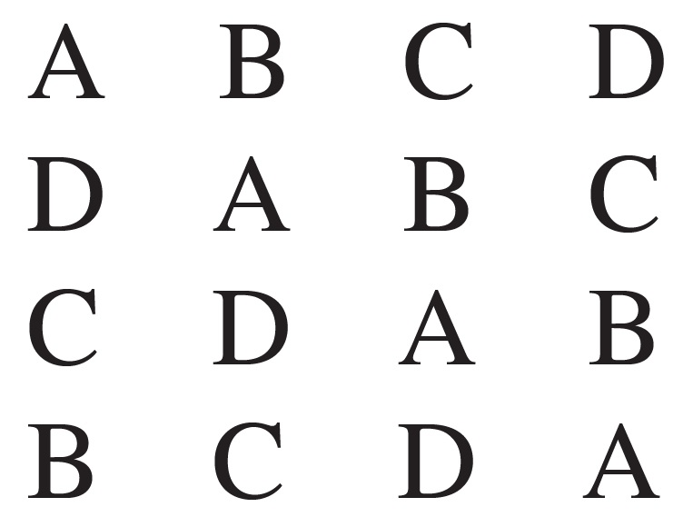
Counterbalancing and the Number of Treatments
A Latin square can be constructed to decide which sequences to select.

Slide 25
Matched-Subjects Designs
Uses a separate group for each treatment condition
Each individual in one group is matched one-to-one with an individual in every other group.
  Matching is based on a variable that is particularly relevant to the specific study.
  Goal: to duplicate all the advantages of within- and between-subjects designs without the disadvantages of either one

Slide 26
Why use Experiments?
The third-variable problem: a study may establish that two variables are related.
  It does not necessarily mean that there is a direct (causal) relationship.
    A third (unidentified) variable may be responsible for producing the observed relationship.

Slide 27
Causation and the Directionality Problem
Directionality problem: a research study may establish a relationship between two variables.
  The existence of a relationship does not always explain the direction of the relationship.
    The remaining problem is to determine which variable is the cause and which is the effect.

Slide 28
Controlling Nature
An experiment must control nature to establish a cause-and-effect relationship.
  The two variables being examined must be isolated from the influence of other variables.
    The exact character of a relationship must be clear.

Slide 29
Advantages and Disadvantages of Control Methods
Holding constant and matching
  Require extra effort or extra measurement
  Holding constant also limits external validity
Randomization
  Controls a wide variety of variables simultaneously
  Is not guaranteed to be successful in balancing variables

Slide 30
Validity Issues in Experimental Research
  Internal Validity – Do conclusions drawn from experimental results accurately reflect what went on in the experiment itself?
    Did the experiment actually measure what it was designed to?
  External Validity – Do conclusions drawn from experimental results generalize to the “real” world?
    How likely could the results replicate outside of the lab?

Slide 31
Manipulation Checks
Directly measure whether the IV had the intended effect on the participant
Ways to check the manipulation:
  Explicitly measure the IV
  Ask specific questions about the manipulation in a questionnaire completed by participants after the experiment

Slide 32
Strengths and Weaknesses of the Experimental Method
Strengths of Experimental Method
    Isolation of experimental variable’s impact over time.
    Replication
    Allow researchers to determine causation!
Weaknesses of Experimental Method
    Artificiality of laboratory settings
    Do participants act differently if they know they are in an experiment?

